Slide 1
Grover's Algorithm

Slide 2
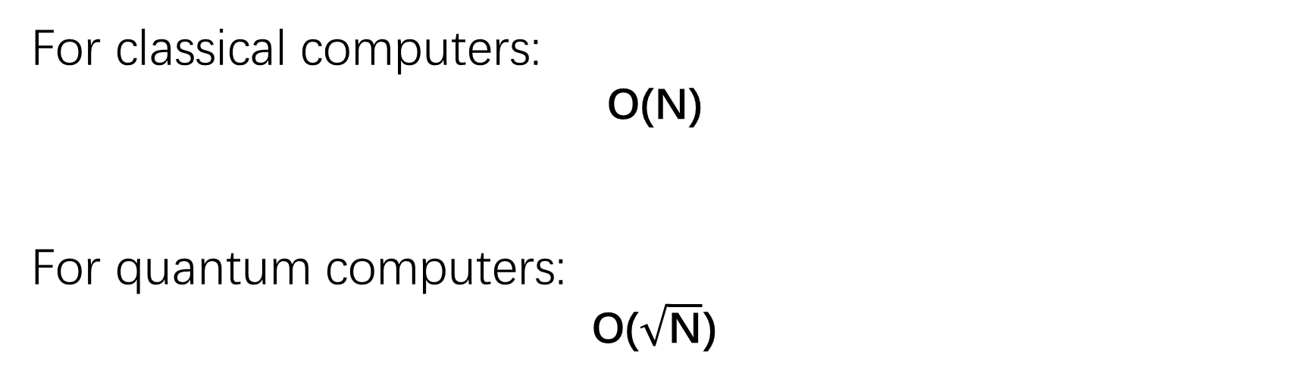
0 | 0 | 0 | 0 | 1 | 0 | 0 | 0
1 | 2 | 3 | … | w | … | N-1 | N=2^n
For classical computers:
O(N)
For quantum computers:
O($\sqrt{\text{N}}$)

Slide 3
Input
f : Σ^{n}→Σ where Σ={0,1}
Output
A string 𝑥 ∈Σ^{n} for which 𝑓(𝑥)=1
Main steps of Grover's algorithm
Initialize an n qubit register 𝑄 to the all-zero state ∣0^{𝑛}⟩and then apply a Hadamard operation to each qubit of 𝑄.
Apply 𝑡 times the unitary operation 𝐺=𝐻^{⊗𝑛} 𝑍_{OR}𝐻^{⊗𝑛}𝑍_{𝑓}​ to the register 𝑄.
Measure the qubits of 𝑄 with respect to standard basis measurements and output the resulting string.

Slide 4
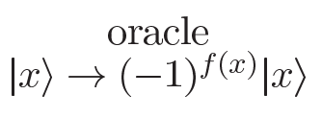

𝑍_{f} gate (search operator)

Slide 5
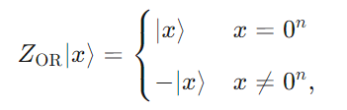



𝑍_{OR} gate (Diffusion operator)

Slide 6
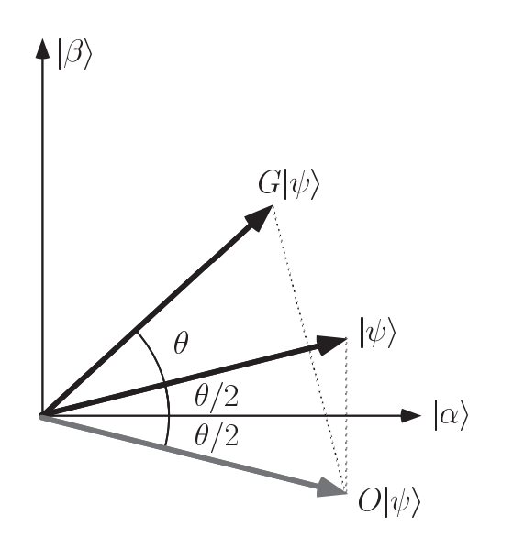


Slide 7
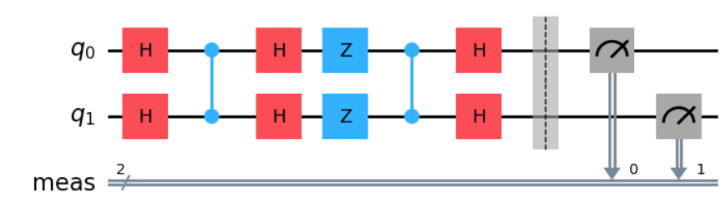
∣φ1⟩
U_{search}
U_{diff}
U_{search}U_{diff}∣φ1⟩

